Slide 1
CSE110
Programming Language I

Slide 2
My Brief Profile
Nahian Salsabil (NNS)
Lecturer, CSE, BRACU
BSc: CSE, BUET, 2023
Email: Email: nahian.salsabil@bracu.ac.bd
Room No. UB80601
Consultation Hour:
Sunday: 11:00am - 1:30pm
Monday: 9:30am - 10:50am, 12:30pm - 1:30pm
Wednesday: 9:30am - 10:50am

Slide 3
Links
Resources: http://tiny.cc/cse110_resources_NNS
Slack: http://tiny.cc/cse110_slack

Slide 4
Outline
List

Slide 5
List
written in square brackets “[]”
elements stored inside separated by commas
Mutable and ordered

Slide 6
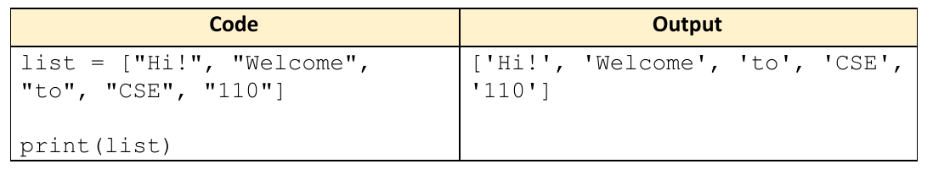
Example

Slide 7
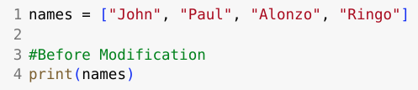



Mutability
Output
Output

Slide 8




Accessing List
Output
Output

Slide 9



Accessing List
Output
Output
Start index is inclusive
End index is exclusive

Slide 10
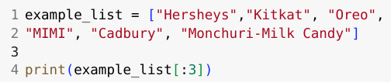

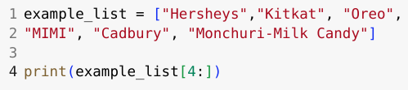

Accessing List
Output
Output

Slide 11
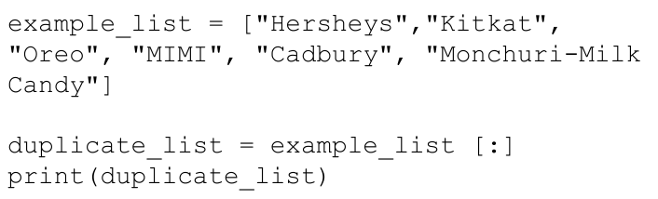
Basic Operations of List
make a copy of items of the list into a new list, using [:] operator:
Output:
['Hersheys',
'Kitkat', 'Oreo',
'MIMI', 'Cadbury',
'Monchuri-Milk
Candy']

Slide 12
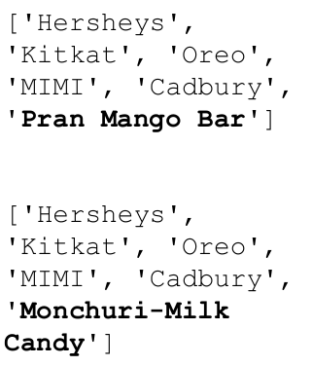
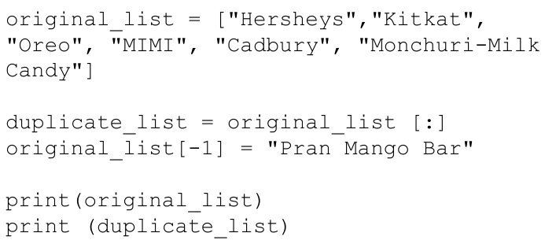
Basic Operations of List
The copied list remains unchanged when the item of original list gets modified:
Output:

Slide 13
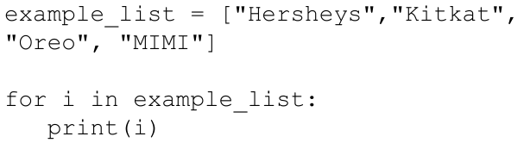
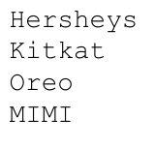
Basic Operations of List
Looping through list using for loop:
Output:

Slide 14
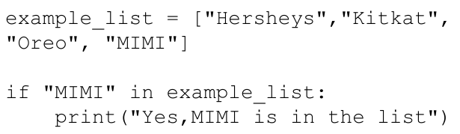

Basic Operations of List
To check if an item exists in the tuple:
Output:

Slide 15
Basic Operations of List
To check if an item exists in the tuple:
Output:

Slide 16
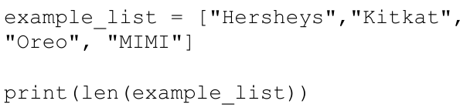
Basic Operations of List
To know the number of items in a list:
Output:
4

Slide 17
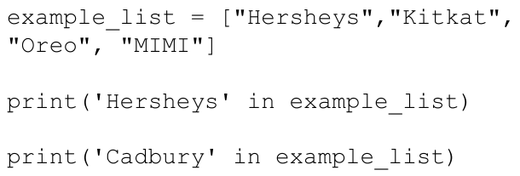
Basic Operations of List
List membership Test​:
Output:
True
False

Slide 18

Methods Associated with List
append()
Output:

Slide 19

Methods Associated with List
count()
Output:
2

Slide 20

Methods Associated with List
insert()
Output:

Slide 21
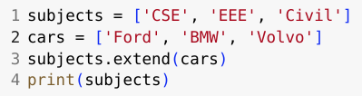
Methods Associated with List
extend()
Output:

Slide 22


Methods Associated with List
remove()
Output:

Slide 23

Methods Associated with List
index()
Output:
2

Slide 24


Methods Associated with List
pop()
Output:

Slide 25


Methods Associated with List
sort()
Output:

Slide 26


Methods Associated with List
reverse()
Output:

Slide 27
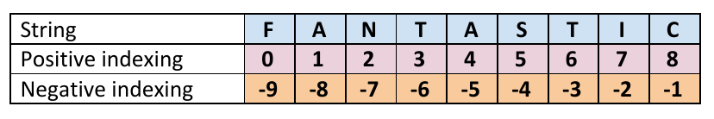
Slicing

Slide 28
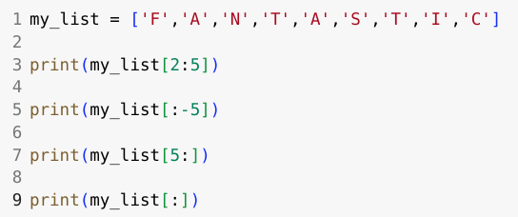
Slicing

Slide 29
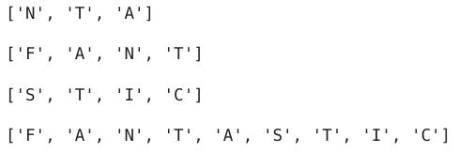
Slicing
Output:

